Slide 1

GENDER INEQUALITY
ASAD RIZVI, BRANDON LAM, DANIEL FUENTES

Slide 2
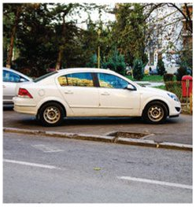
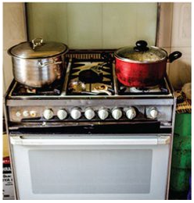
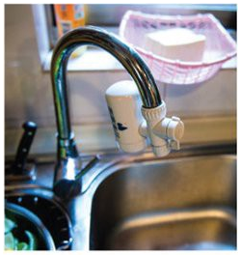

Slide 3
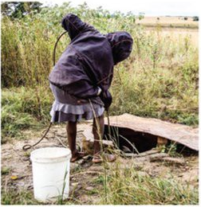
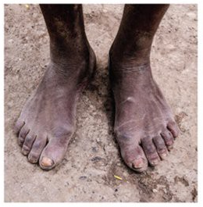
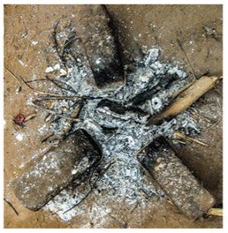

Slide 4
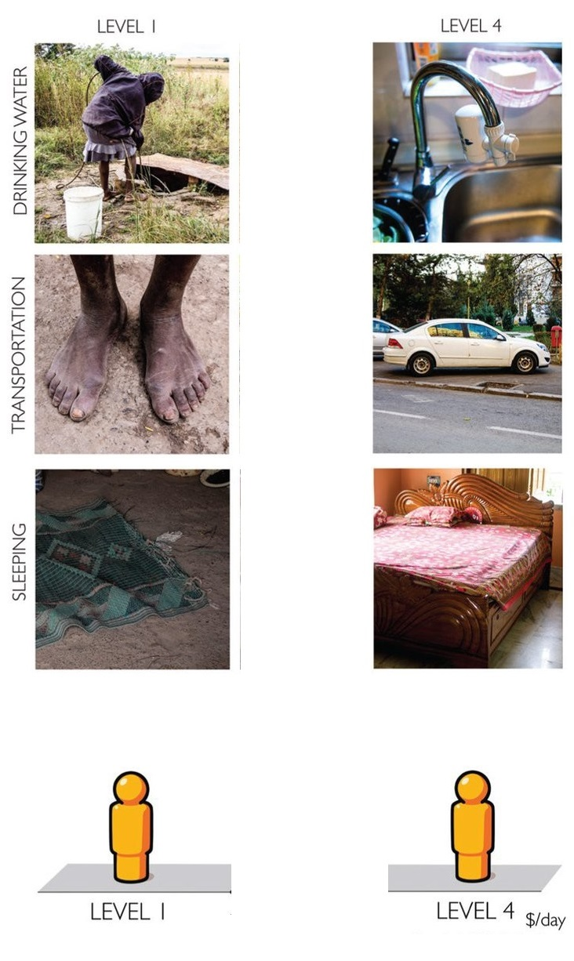

Slide 5
WHAT IS INEQUALITY?
Social inequality is the existence of unequal opportunities and rewards for different social positions or statuses within a group or society.

Slide 6
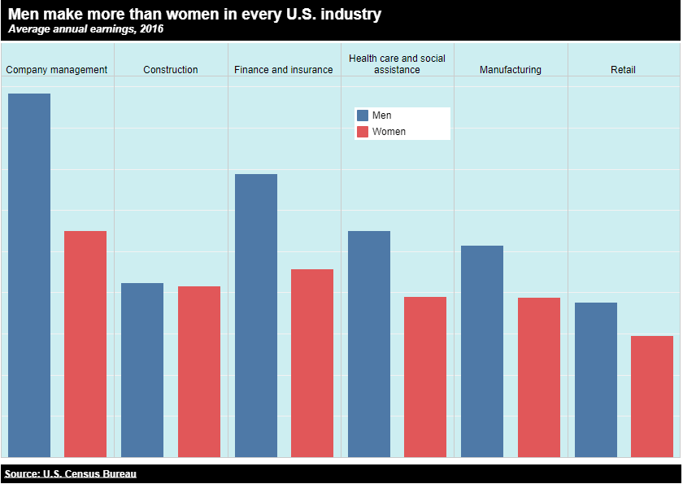
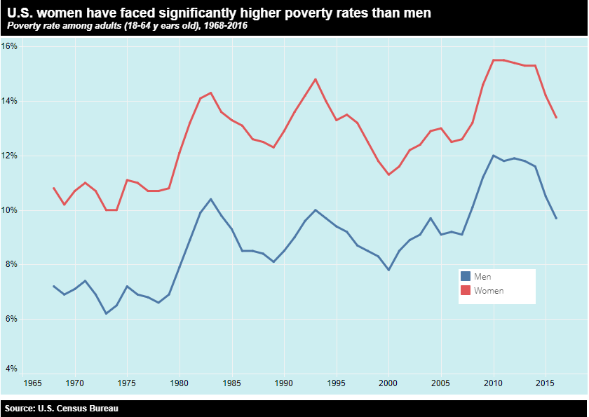
INEQUALITY IN THE UNITED STATES TODAY
V

Slide 7
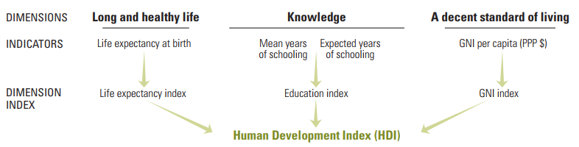
WHAT IS HDI?

Slide 8
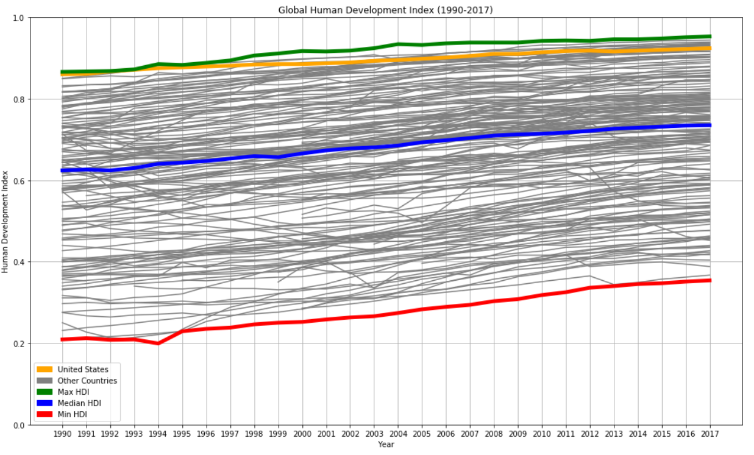

Slide 9
Why gender inequality?
54% of the global population are women.
Gender inequality is present in every society

Slide 10
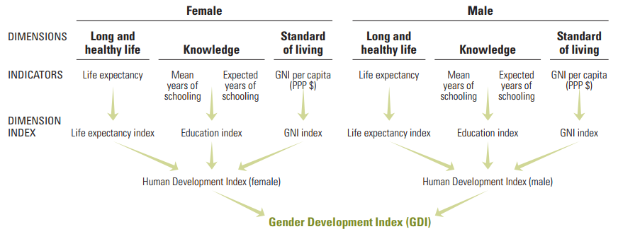
WHAT IS GII?

Slide 11
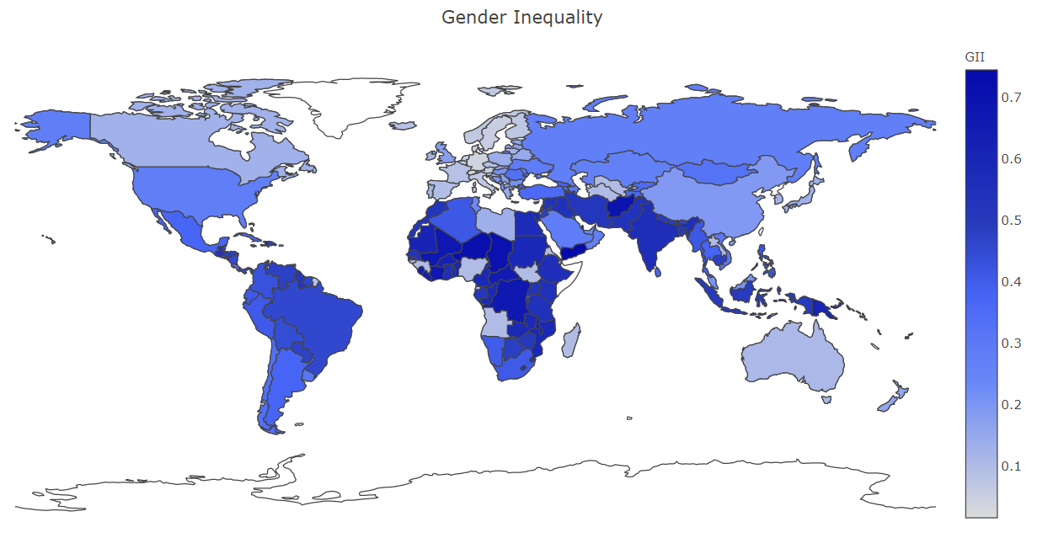

Slide 12
THE FEATURES OF GENDER INEQUALITY
Maternal Mortality Ratio: maternal deaths per 100 000 live births
Adolescent Birth Rate: births per 1,000 women ages 15-19
Percent Representation in Parliament: Share of parliamentary seats held by each sex (PR)
Population with Secondary Education (Male/Female) Percentage of attainment at secondary and higher education (SE) levels of specific gender population
Labour Force Participation Rate (Male/Female): The labour force participation rate is a measure of the proportion of a country’s working-age population that engages actively in the labour market, either by working or looking for work

Slide 13
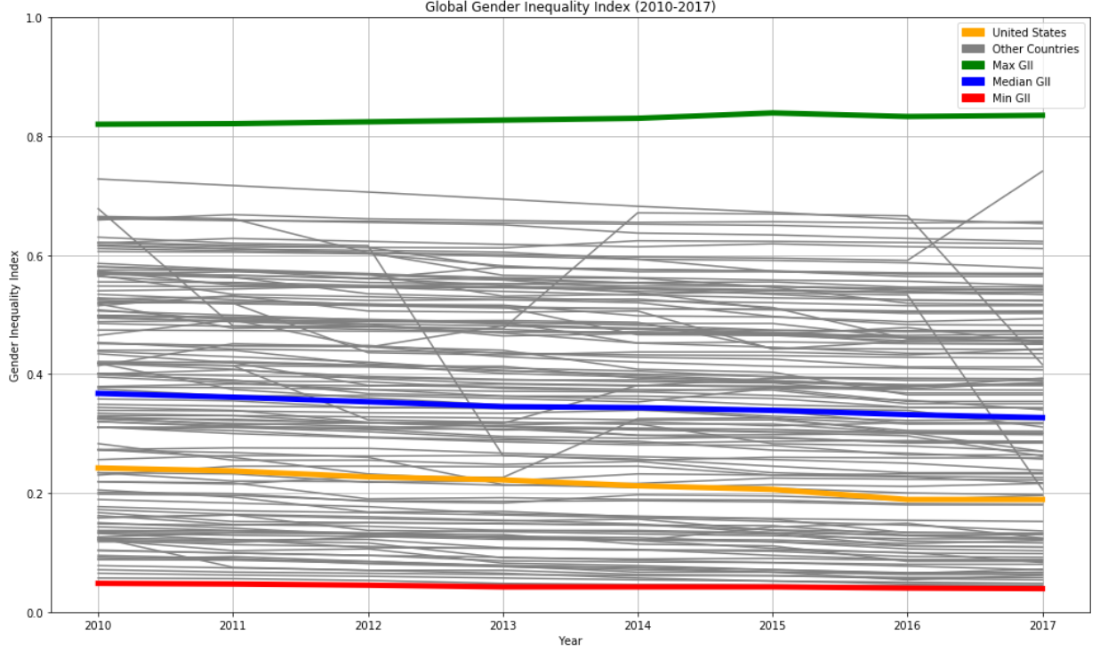

Slide 14
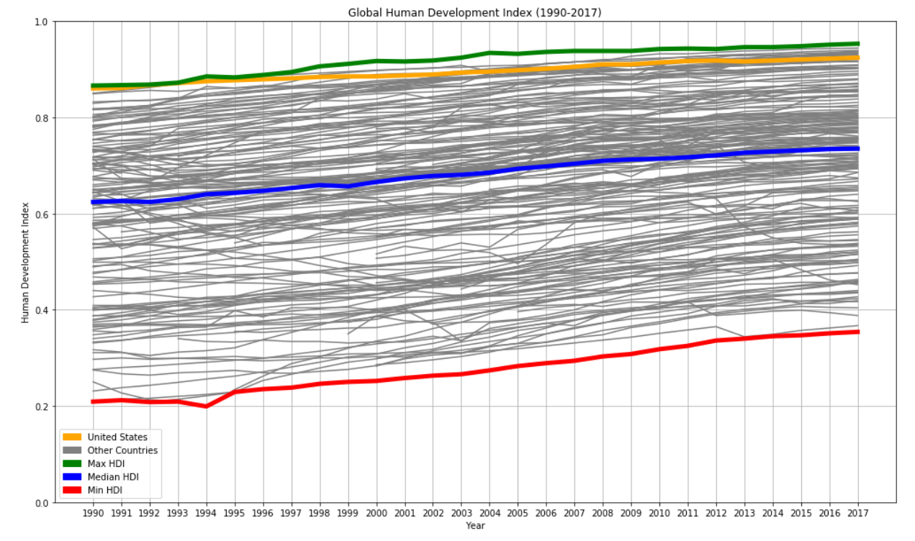

Slide 15
GII
Gender inequality has a negative impact on the human development index due to a higher disparity between human beings.
The GII is an inequality index. It measures gender inequalities in three important aspects of human development—reproductive health, measured by maternal mortality ratio and adolescent birth rates; empowerment, measured by proportion of parliamentary seats occupied by females and proportion of adult females and males aged 25 years and older with at least some secondary education; and economic status, expressed as labour market participation and measured by labour force participation rate of female and male populations aged 15 years and older.

Slide 16
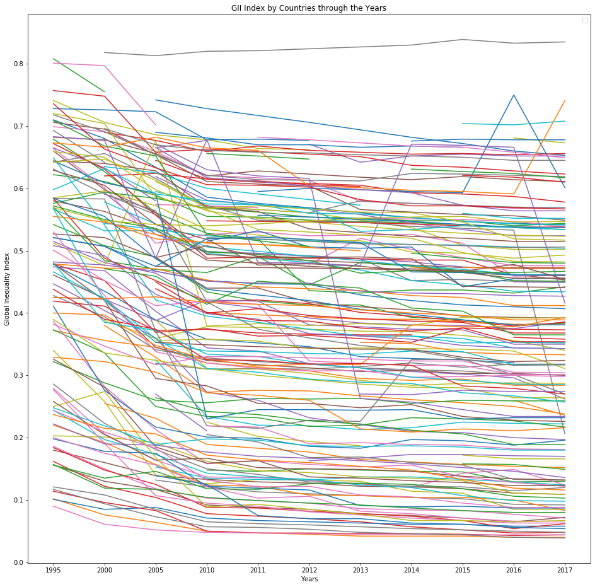

Slide 17
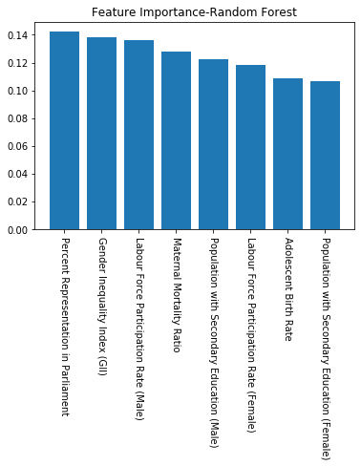
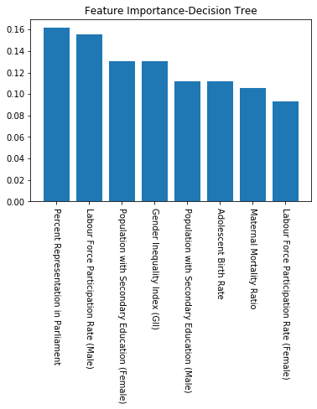

Slide 18
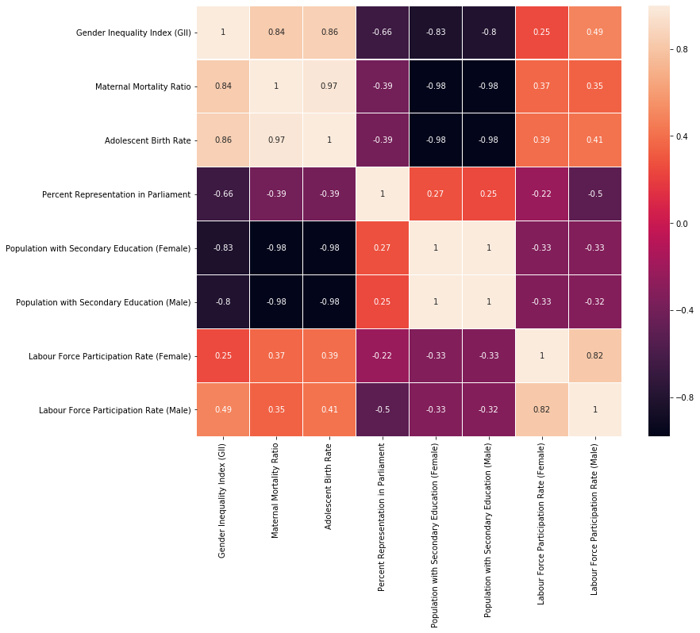
Correlation Heatmap

Slide 19
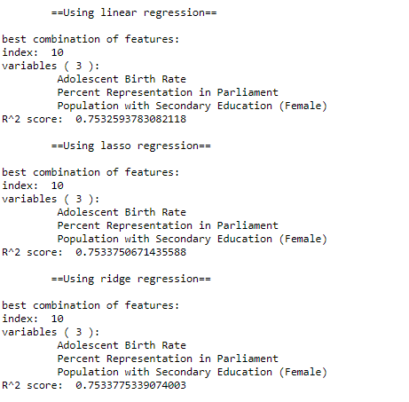
10. Finding the best combination of features to predict gender inequality index (GII)
Purpose of feature selection:
Identifying greatest contributors to gender inequality and create a plan of action to reduce it long term.
Approach:
Created superset of features.
Made linear, lasso, and ridge models for every combination of features
Calculated coefficient of determination (R^2) corresponding to each combination features using cross validation.
Selected desired number of features and combination with highest R^2.
No significant difference in score accuracy found between the 3 models.

Slide 20
Features Selected:
Adolescent Birth Rate
Percent Representation in Congress
Population with secondary education

Slide 21
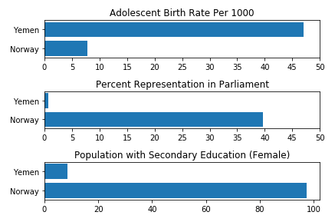
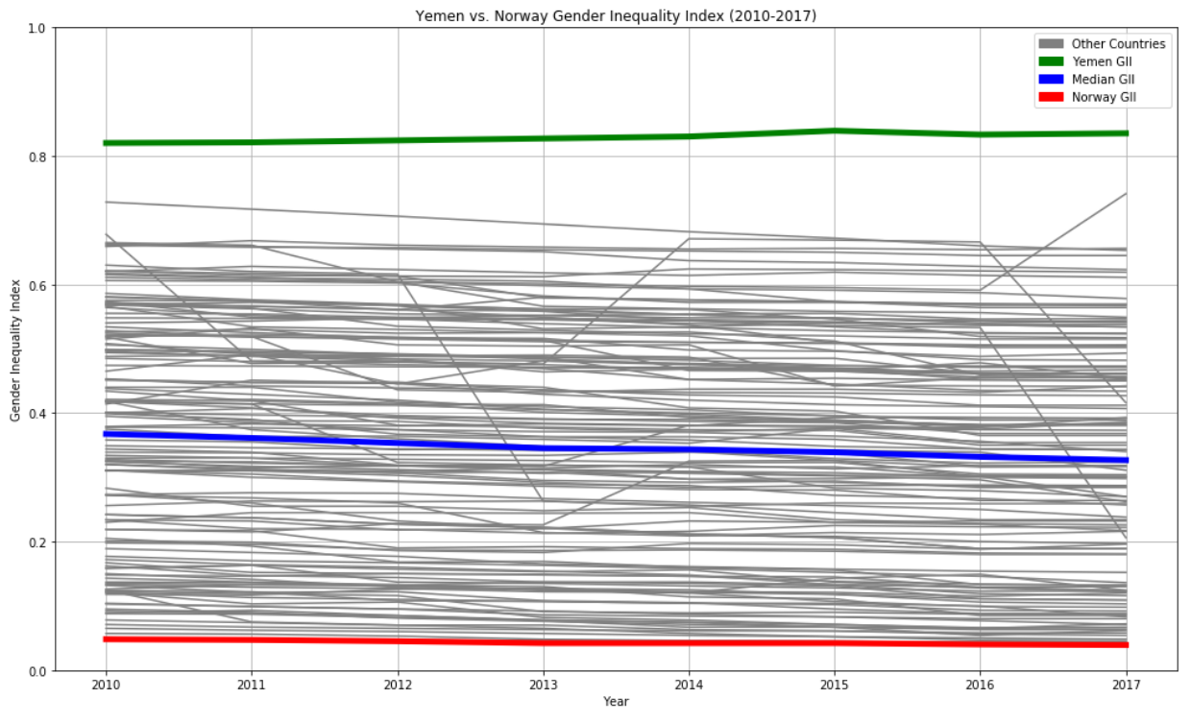
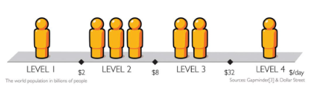
High vs Low GII countries

Slide 22
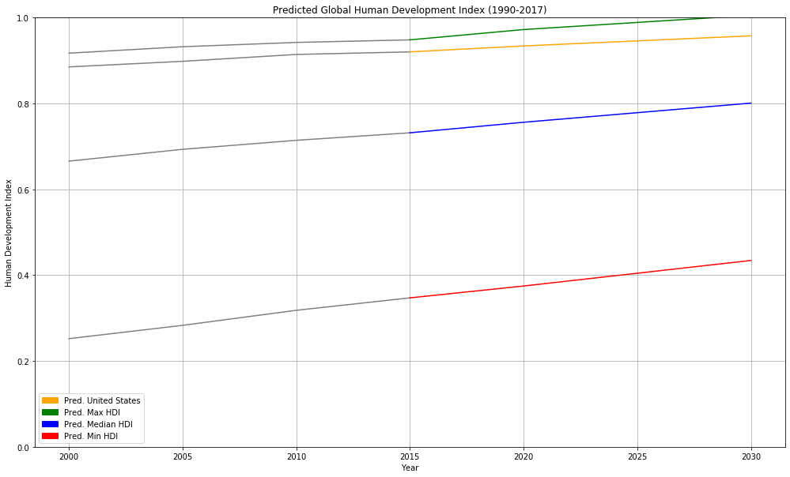

Slide 23
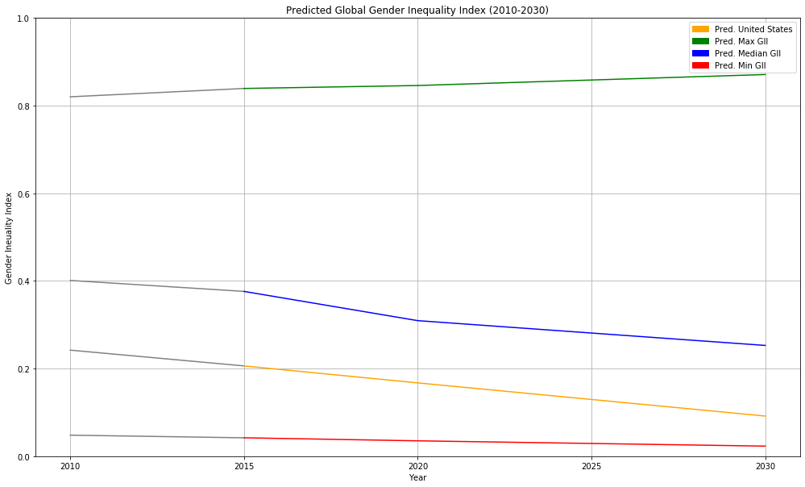

Slide 24


What can be done?
Adolescent Birth Rate
Percent Representation in Congress
Population with secondary education

Slide 25

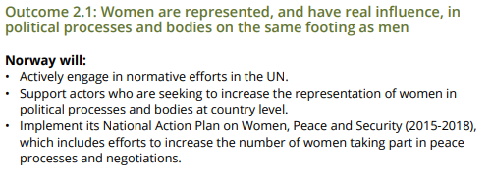
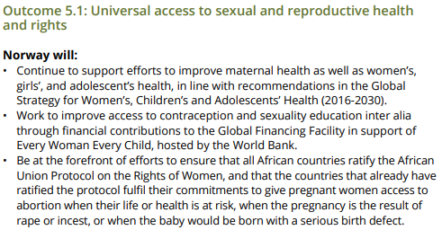
Population with secondary education
Percent Representation in Congress
Adolescent Birth Rate

Slide 26

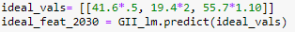
Results:
Using our 3 feature model:
A 50% improvement in Adolescent Birth Rate
Doubling Women Participation in Parliament
A low 10% in Population with secondary education
10% Improvement globally

Slide 27
Conclusion

